Slide 1
Final Project
Flight Landing Scheduling
Team 2
Chirag Chandnani, Paramjeet Kour,
Chun-Wei Hung, Xuan Li
BIA 650
Fall 2021

Slide 2
Content
01.
Introduction
02.
Data & Model
03.
Model Visualization
04.
Business impact & conclusion

Slide 3
Background
Airports usually allow sufficient time for plane to land
Greatly increases the cost of the airport, the waiting time of the remaining aircraft has increased
Design a DSS in airport to reduce personnel
Reduce flight waiting time and increase airport profits

Slide 4
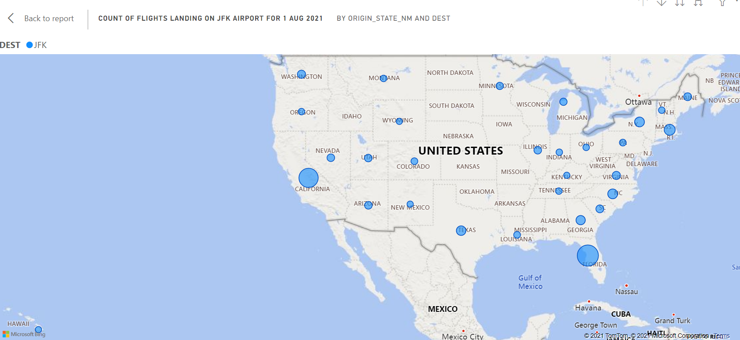
Data selection

Slide 5
Background
Airports usually allow sufficient time for the plane to land
Greatly increases the cost of the airport, beacuse the waiting time of the remaining aircraft has increased
Design a decision support syetem to reduce the number of personnel and increase airport profits

Slide 6
Stakeholder
Airlines companies----reduce wait time and increase the number of flights to increase profits
Airport----reduce the number of personnel
Passengers----choice becomes more flexible and travel becomes more convenient

Slide 7
Data Used
Data that was used to create this model is collected by US Govt Agency
Bureau of Transportation Statistics
This csv file contains the details of all the Flights that are flying in or out of all the US airports for the month of August 2021.

Slide 8
Data Used
Steps taken to process/clean the data
Query the data for the Model
We have used Mixed Integer Programming with Goal Programming for designing a prototype for the flight data.(Using Evolutionary Solver)
Goal: Minimize Delay(i.e sum of all delays for all flights)

Slide 9
Model
Wheels On Time, ARR time, CRS Arrival Time, Delay Observed
Decision Variables
Runway assigned(R1 through R4) array for a particular runway
Constraints:
R1+R2+R3+R4=1 for all planes and R1 through R4 should be binary as well
Taxi at Times for Planes that have landed must be less than Wheels On time of new plane that is coming into that runway

Slide 10
Scope Of the Project
This Project is not limited to aviation industry only it can also be implemented in various other industries as well such as:
Multilevel Car Parks: Can be implemented in the similar way in the Maritime Industry where Docks can be taken in place of runway(aviation).
Public Transportation System(Buses)
Basically, can be used to optimize a process where it has different paths that an activity can take and find the one with least delay for that activity

Slide 11
Model Visualization

Slide 12
Model Visualization

Slide 13
Business Impact
As we preciously mentioned
Other industries need to spend time on waiting
With our model:
Save time for both customers and business
Gain more surplus and profit from the extra time
Create more advantages for the whole society!!

Slide 14
Conclusion
The model can reduce an average of 17.94% of delay time
Accurate timing control boost reputation of the airport
Make airport more reliable for customer
Enhance cooperation willingness of airlines to cooperate with the airport

Slide 15
Thanks for your listening!

